Slide 2
design systems - material design system apple HIG
Duration: 40 mins
Session by: Rajesh Seth, Dhiraj More

Slide 3
design systems - material design system and apple HIG
at the end of this session
understand what a design system
why we need one, its benefits, and all of the elements that make up a design system.
learn how the design system methodology represents our design workflow. design system methodology
understand how to develop real design systems using design tools.
learn about apple hig, material design, and the distinctions between the two.

Slide 4
why we need design system?
design systems - material design system and apple HIG
wasted time resolving recurring problems
developer effort halted by design iteration
maintenance becomes a nightmare
inconsistent design
poor product decisions

Slide 5
design systems - material design system and apple HIG
problems of not having a design system
new styles, patterns, ideas…
frankenstein
product launch
new styles, patterns, ideas…
new styles, patterns, ideas…
Notes:
As requirements change and we uncover new design considerations, designers will inevitably need to update the pages that they had previously designed. This leads to two scenarios: the developers are constantly blocked having to wait for design iterations or the development team forges ahead without designs and delivers inconsistent or off-brand user experiences.

Slide 6
what is design system?

Slide 7
what is design system
design systems - material design system and apple HIG
a single source of truth
a collection of reusable components
scalable and reusable
unites the team around a common visual language.
guided by clean standards that can be assembled to build, like Lego.
the heart and primary value of Design Systems.

Slide 8
A design system is all of this…
design systems - material design system and apple HIG
design language
component library
developer sandbox
design kit
documentation
Notes:
There's a common misconception that a Design System is just a Style Guide or a Component Library, terms people often use interchangeably. However, in our opinion, those are both sub-components of a Design System.

Slide 9
atomic design system methodology

Slide 10

design systems - material design system and apple HIG
methodology - taking cues from chemistry
All matter (whether solid, liquid, gas, simple, complex, etc) is composed of atoms. Those atomic units bond together to form molecules, which in turn combine into more complex organisms to ultimately create all matter in our universe.
http://atomicdesign.bradfrost.com/chapter-2/

Slide 11
design systems - material design system and apple HIG
by Brad Frost
atomic design methodology
Similarly, interfaces are made up of smaller components. This means we can break entire interfaces down into fundamental building blocks and work up from there. That’s the basic gist of atomic design.
atoms
molecules
organisms
templates
pages
http://atomicdesign.bradfrost.com/chapter-2/

Slide 12
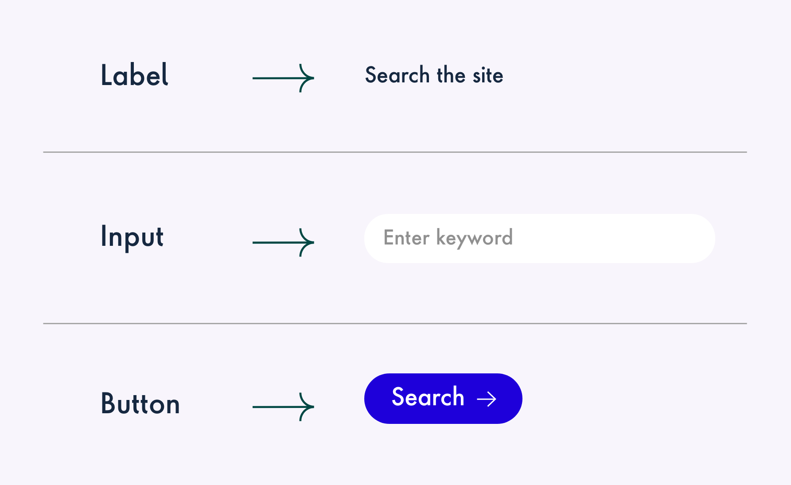
design systems - material design system and apple HIG
atom
Atoms are the basic building blocks of matter. Atoms can also include more abstract elements like color palettes, fonts and even more invisible aspects of an interface like animations.
http://atomicdesign.bradfrost.com/chapter-2/

Slide 13
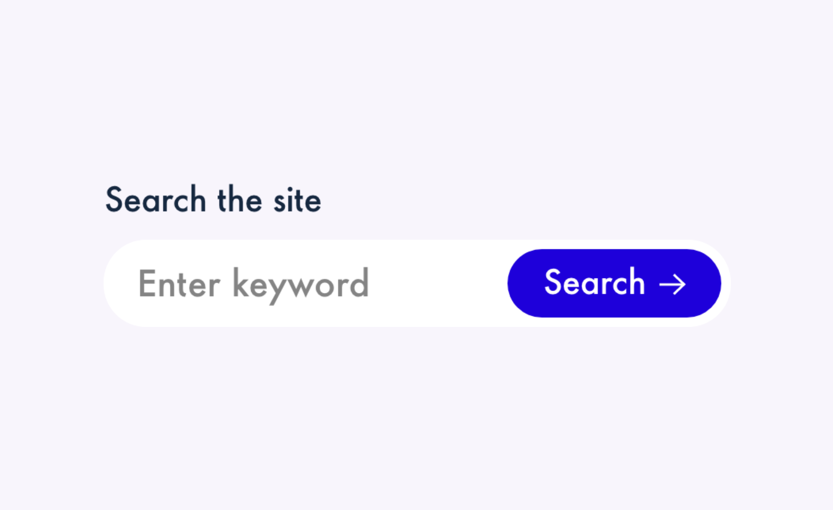
design systems - material design system and apple HIG
molecules
things start getting more interesting and tangible when we start combining atoms together. molecules are groups of atoms bonded together and are the smallest fundamental units of a compound. these molecules take on their own properties and serve as the backbone of our design systems.
http://atomicdesign.bradfrost.com/chapter-2/

Slide 14

design systems - material design system and apple HIG
molecules
Molecules give us some building blocks to work with, and we can now combine them together to form organisms. Organisms are groups of molecules joined together to form a relatively complex, distinct section of an interface.
http://atomicdesign.bradfrost.com/chapter-2/

Slide 15
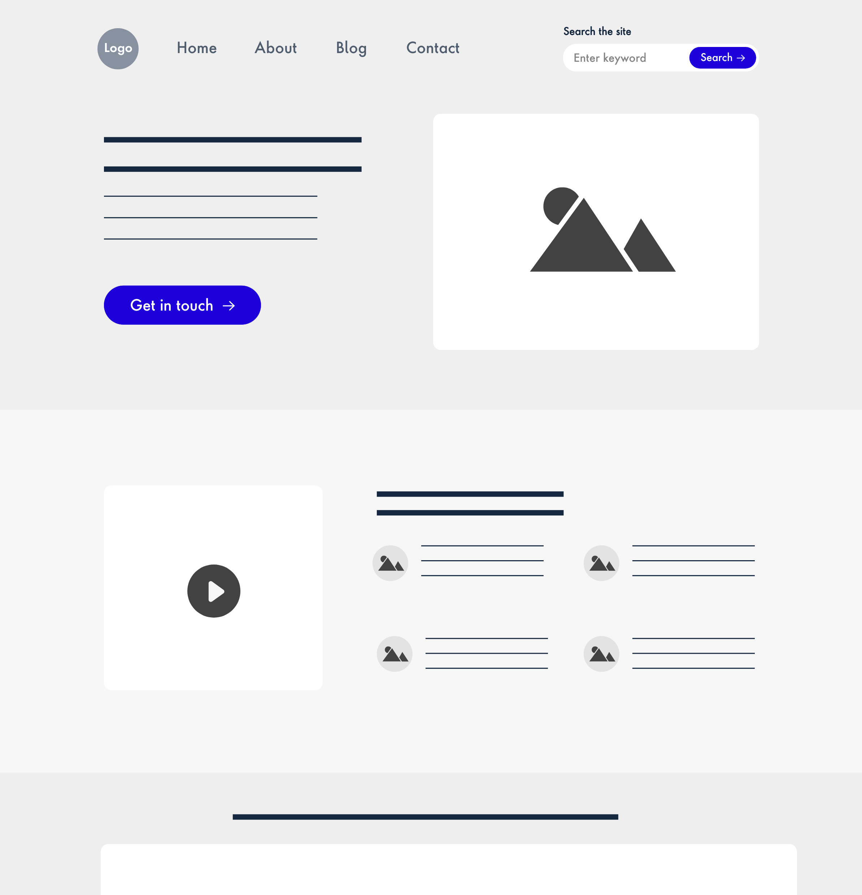
design systems - material design system and apple HIG
templates
at the template stage, we break our chemistry analogy to get into language that makes more sense to our clients and our final output.
templates consist mostly of groups of organisms stitched together to form pages. it’s here that we start to see the design coming together and start seeing things like layout in action.
http://atomicdesign.bradfrost.com/chapter-2/

Slide 16
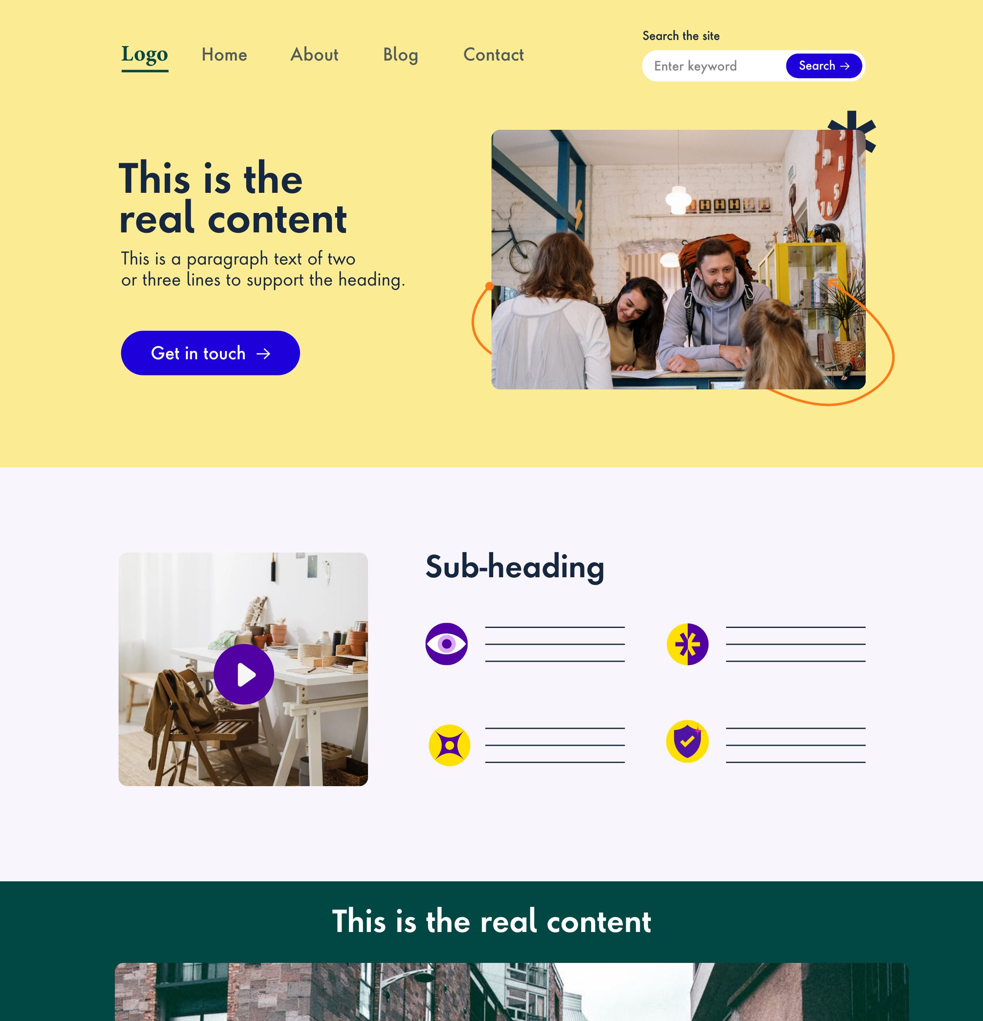
design systems - material design system and apple HIG
pages
pages are specific instances of templates. here, placeholder content is replaced with real representative content to give an accurate depiction of what a user will ultimately see.
http://atomicdesign.bradfrost.com/chapter-2/

Slide 17
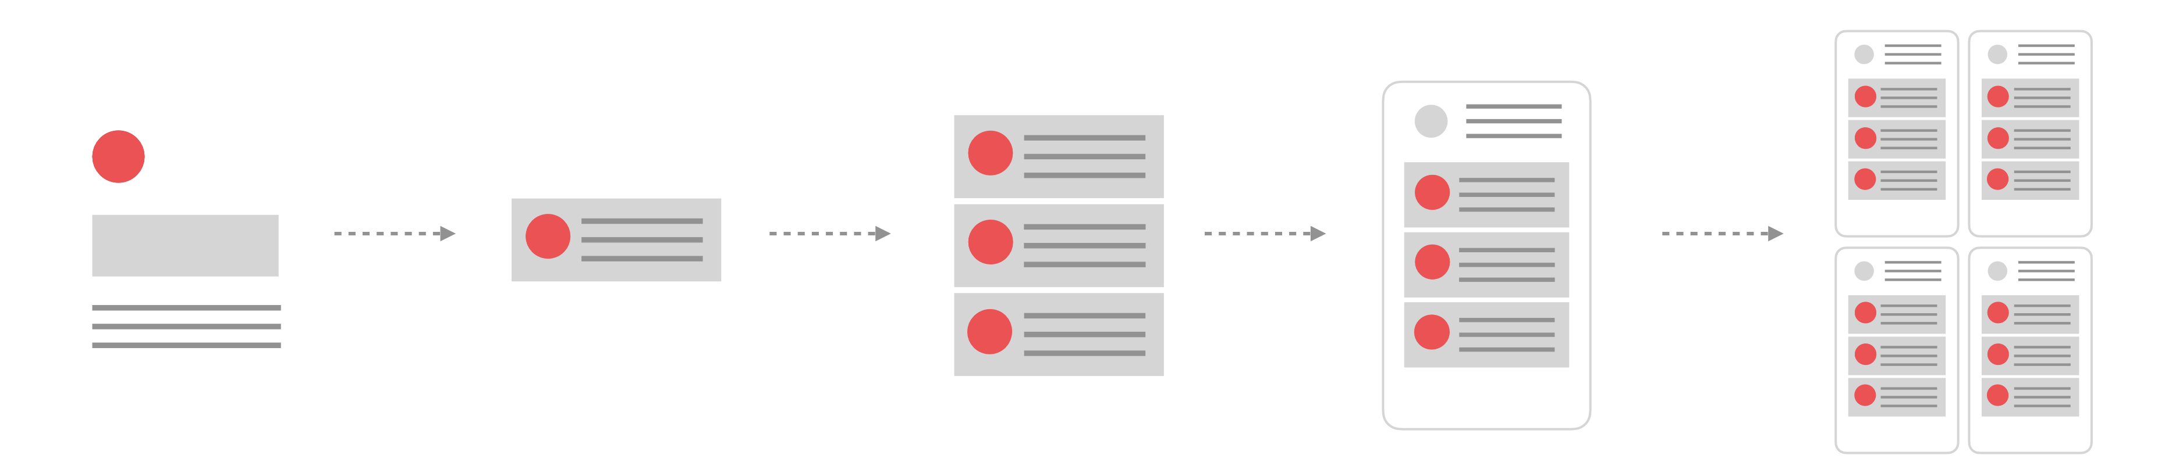
design systems - material design system and apple HIG
the atomic approach focuses us on creating a structure of smaller elements that can be used on their own or combined to make larger components throughout our designs providing benefits both to the business and the user.
atoms
molecules
organisms
templates
pages

Slide 18
design system elements
design systems - material design system and apple HIG
content
guidelines
micro interactions
visual design language
typography
& scale
style guide
component/ pattern library
a11y guidelines
design principles
UI tools kits
dev code
standards
interactive prototyping tools
voice & tone

Slide 19
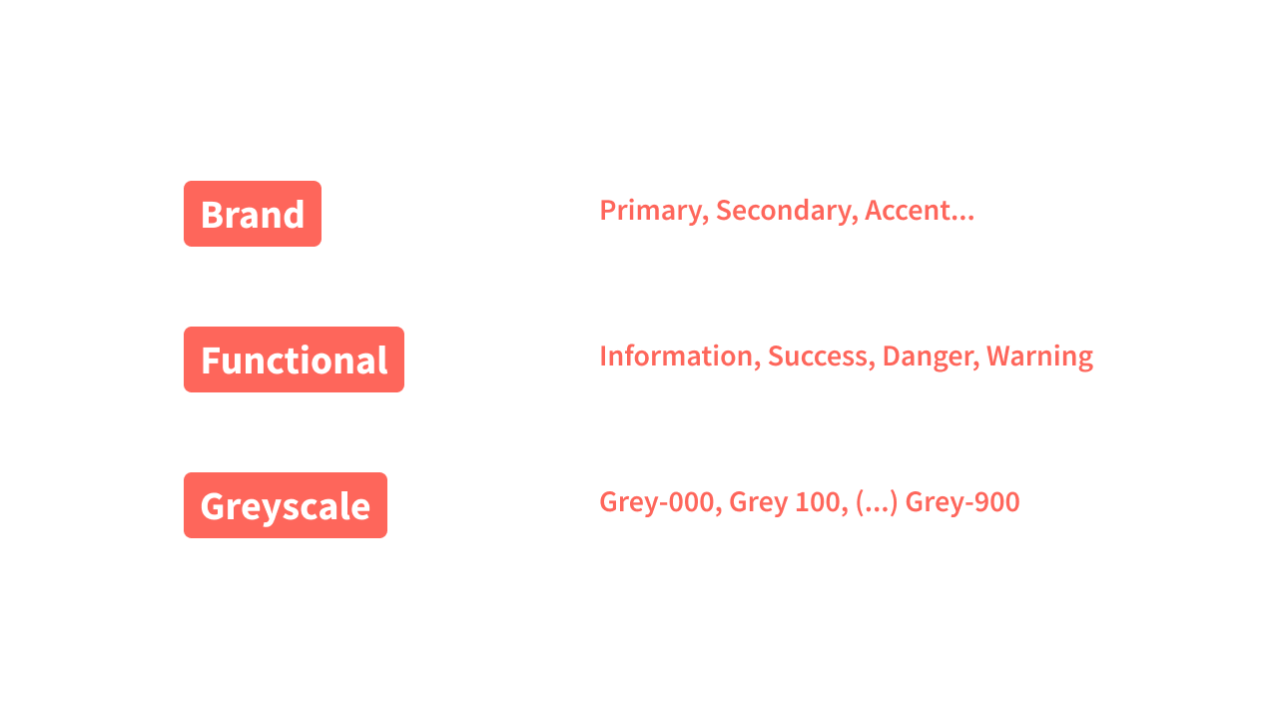
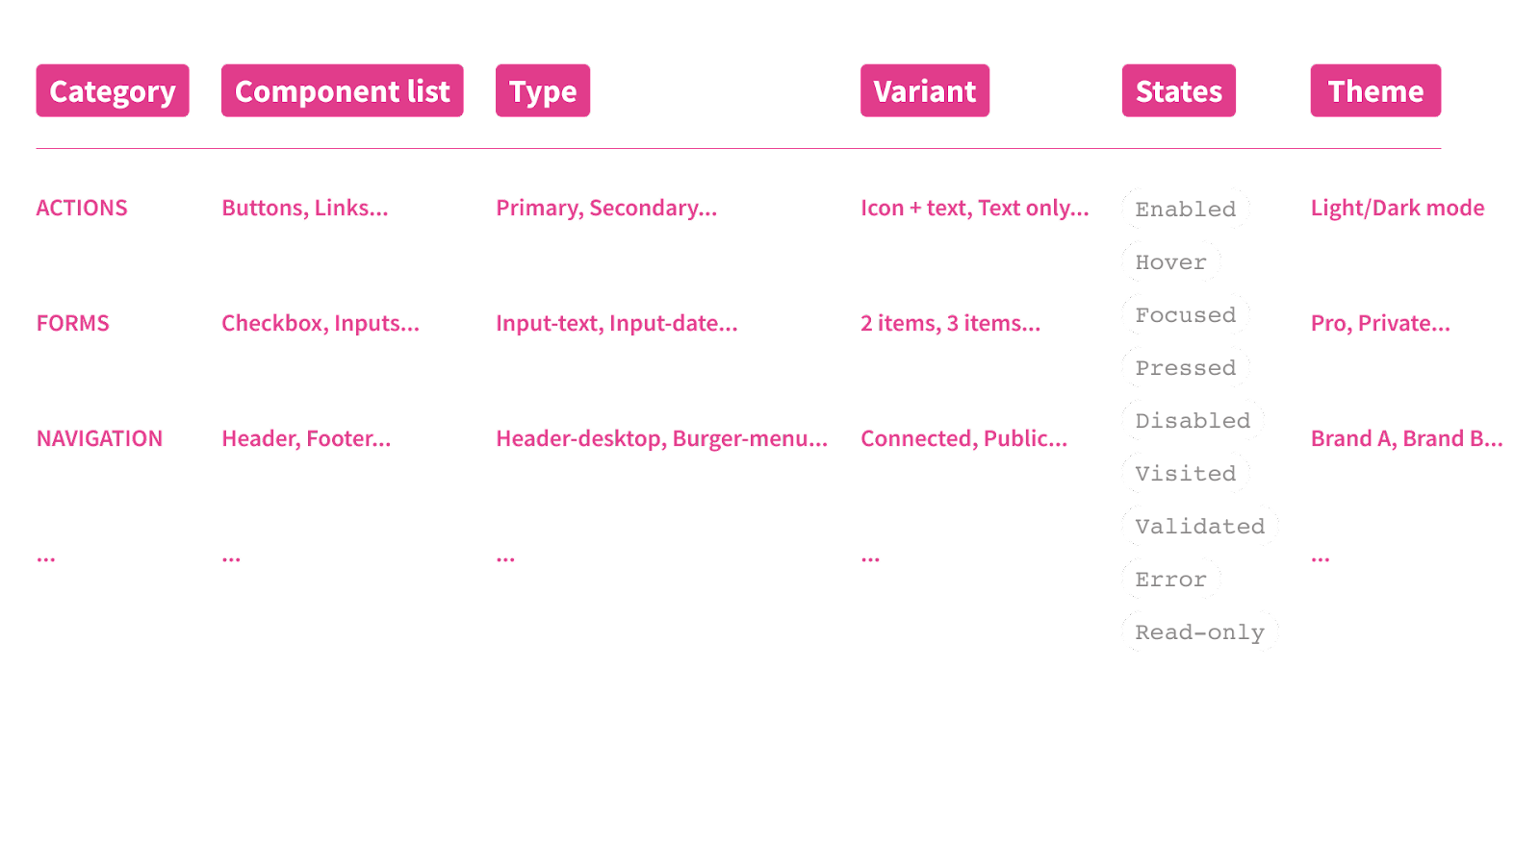
naming conventions
design systems - material design system and apple HIG
Colors
{Theme}[Category] / [Component List] / [Type / Variant] / [State]

Slide 20
naming conventions
design systems - material design system and apple HIG
Colors
kebab-case
Used for CSS and HTML5.
camelcase
pascalcase
This is the best suited for design needs.
it’s more consistent if you use numbers or t-shirt sizes (grey-100 or spacing-xl, for example).
It’s easier in tools such as Figma to select only one word between each hyphen if you need to edit your naming.
it’s more suitable for design system needs since it is mainly used for web languages (CSS and HTML5)
Used for JavaScript
Used for C# and Java
snake_case
Used for SQL databases PHP or Python

Slide 21
Advantages
design systems - material design system and apple HIG
consistency
single source of truth
increase brand trust
In the visual design language
quick onboarding
through unified brand experiences
speed of delivery
shared language with dev
reduce redundancy
From idea to production
Easy hand-off
Increased internal sharing
Notes:
Reusability of design assets
Improve consistency in our work
Improve efficiency with a faster workflow
Make our projects easier to manage
Make our assets portable
Our work scale long term
Higher Quality
Shared Vocabulary
Easier to Test
Useful Reference
Future Friendly

Slide 22
demo

Slide 23
our design tools
design systems - material design system and apple HIG
prototyping
Sketch
Figma
Adobe XD
inVision
Figma
Principle

Slide 24
material design vs apple HIG

Slide 25
What is material design?
design systems - material design system and apple HIG
The entire design system, its design language, and all its documentation now live at material.io
developed by google in 2014
helps to build high quality digital experience
adaptable system
backed by open-source code
Material Design provides standards for designing UI and UX for applications across desktop, browser and mobile devices.
Contains guidelines, components, and tools that support the best practices of user interface design..
Streamlines collaboration between designers and developers, and helps teams quickly build beautiful products
Notes:
Released in 2014, Google Material Design has a set of guidelines and principles for enduring with the material design rules. Anyone who is willing to make their Android a material design UI will have to follow these rules to give the same look on all Android devices.
Google’s Material Design offers the Android app development company to produce apps with the same icons over different platforms, enhancing user experience. It helps users to navigate smoothly throughout the app yet maintaining a clean user interface.

Slide 26
What are Apple human interface guidelines?
design systems - material design system and apple HIG
apple published its hig in 1987
help to build high quality digital experience
clean and
simple
design apps quickly and accurately
The entire design system, its design language, and all its documentation find here: -https://developer.apple.com/design/human-interface-guidelines/guidelines/overview/
Apple HIG provides standards for designing UI and UX for applications across desktop, browser and mobile devices.
Apple designed its products to look clean, simple and straightforward.
by using Sketch, Photoshop, and XD templates, guides, and other resources.
Notes:
Apple's tradition of Human Interface Guidelines in keeping them simple and legible goes long back. 1987 was the year that the Macintosh II, Apple's first Macintosh was released with a colored display (supporting a spectrum of 256 colors). It was also the year Apple published its Human Interface Guidelines.
The HIG enables applying the visual design and creating consistent access to and behavior of the interface’s common elements — from simple ones like buttons and icons up to more complex constructions like dialog boxes
Apple's Human Interface Guidelines (HIG) is a comprehensive resource for designers and developers looking to create great experiences across Apple platforms.

Slide 27
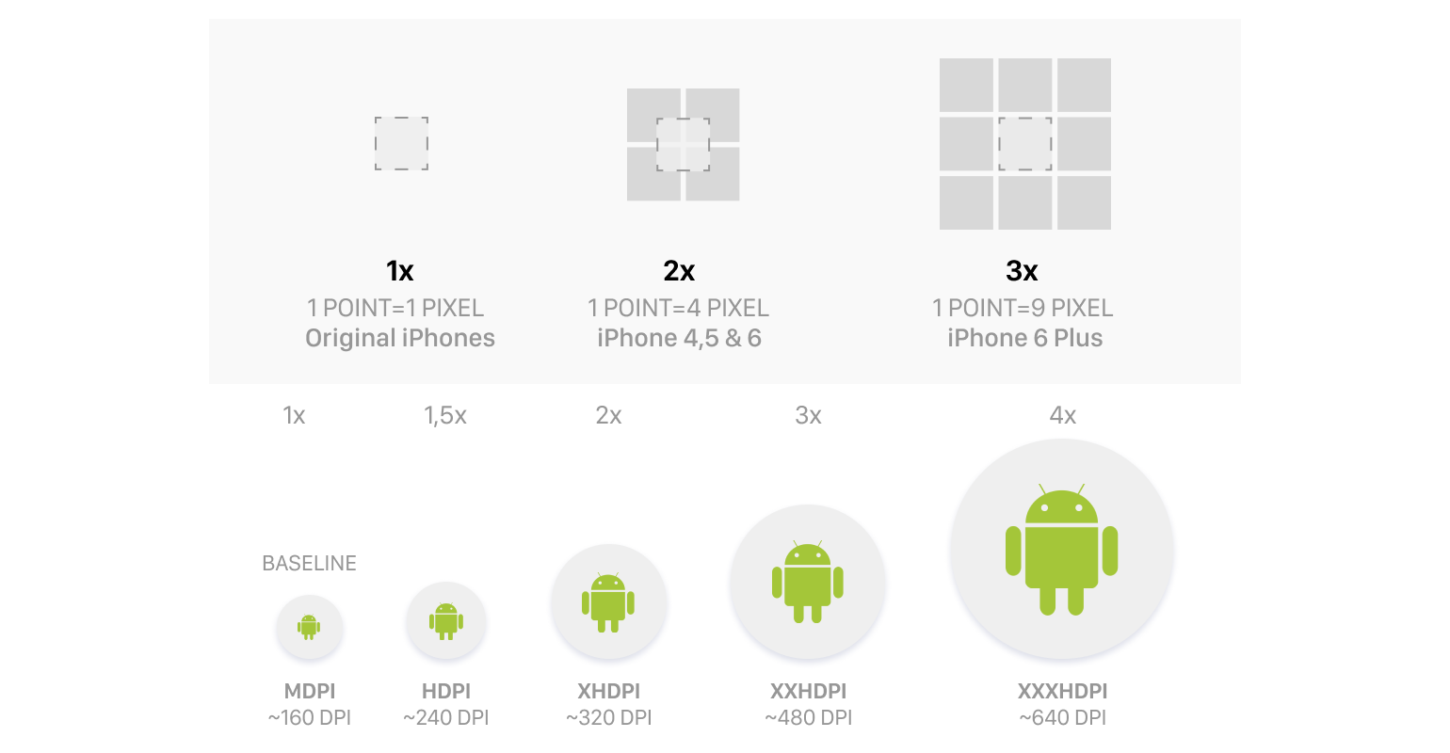
unit of measurement
design systems - material design system and apple HIG
For iOS:
pt (points)
For Android:
dp (dips, or density-independent pixels)

Slide 28
tap targe size
design systems - material design system and apple HIG
For Android:
48x48 minimum
For iOS:
44x44 minimum
Button
44
Button
48
44
48

Slide 29
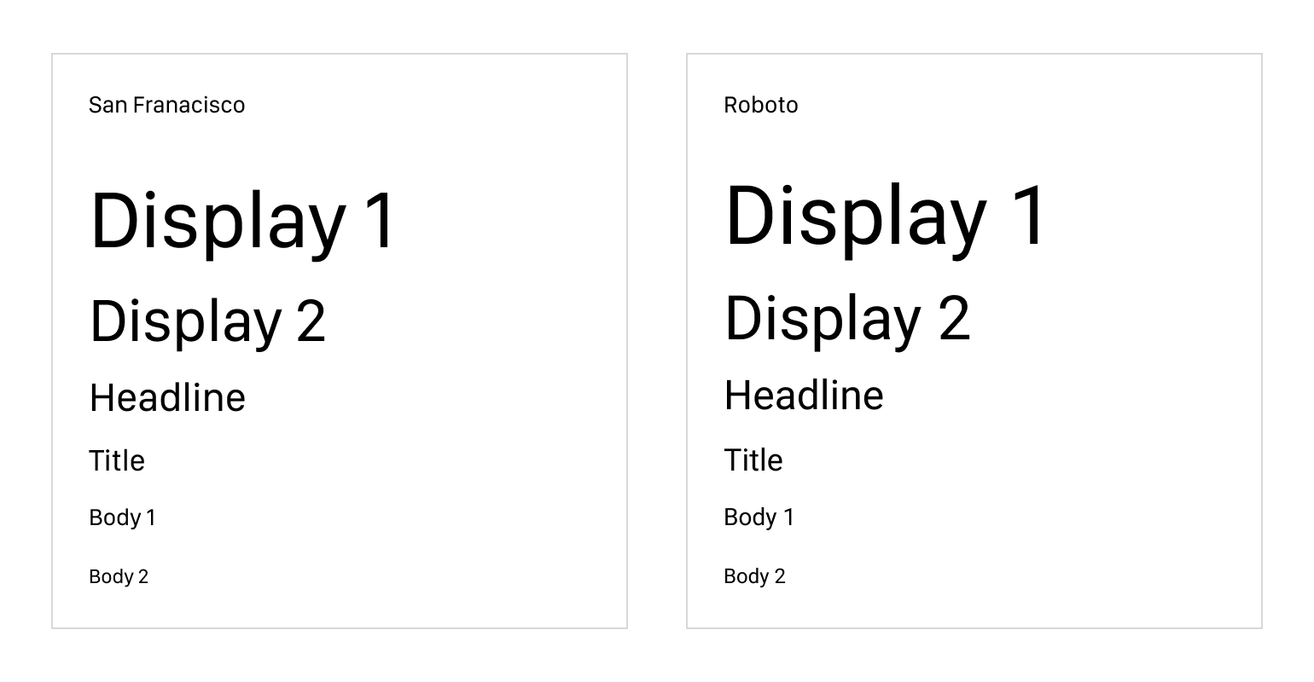
system font (typography)
design systems - material design system and apple HIG
For iOS:
Francisco, 17pt for the base font
For Android:
48x48 minimum

Slide 30
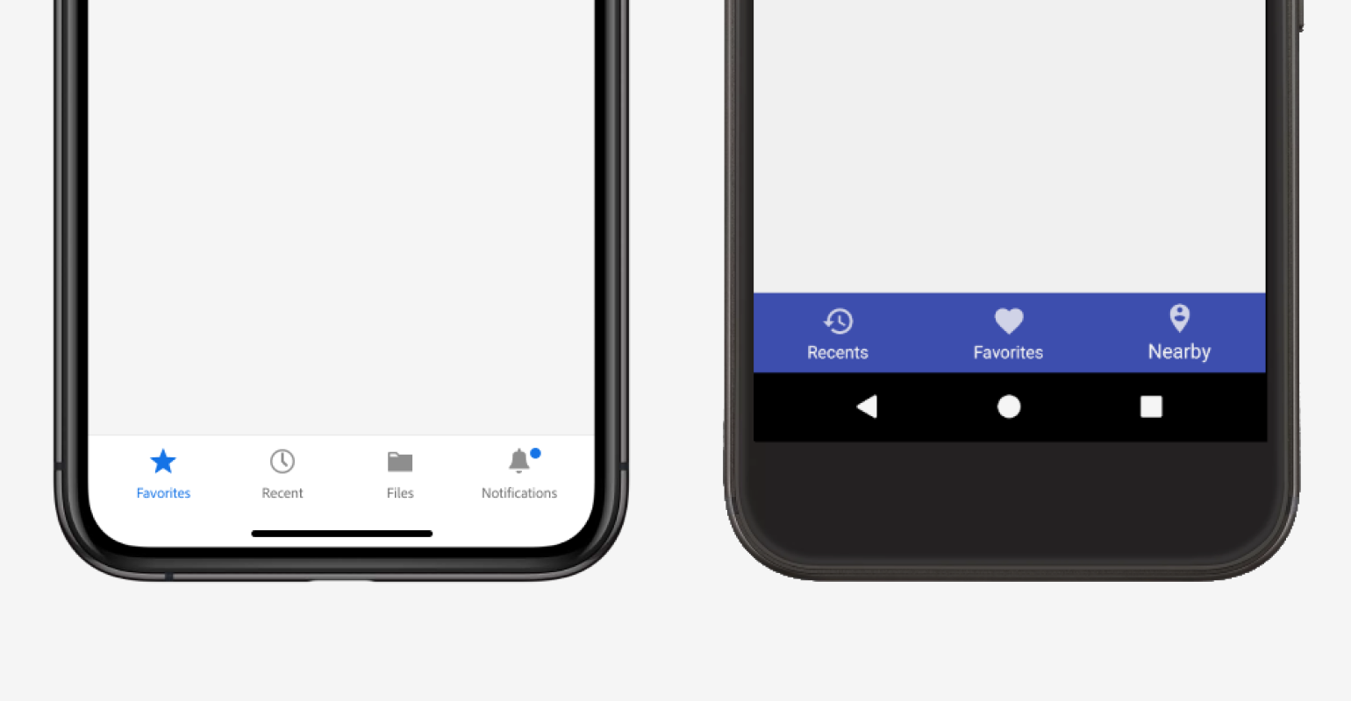
navigation
design systems - material design system and apple HIG
For Android:
bottom navigation bar
For iOS:
tab bar

Slide 31
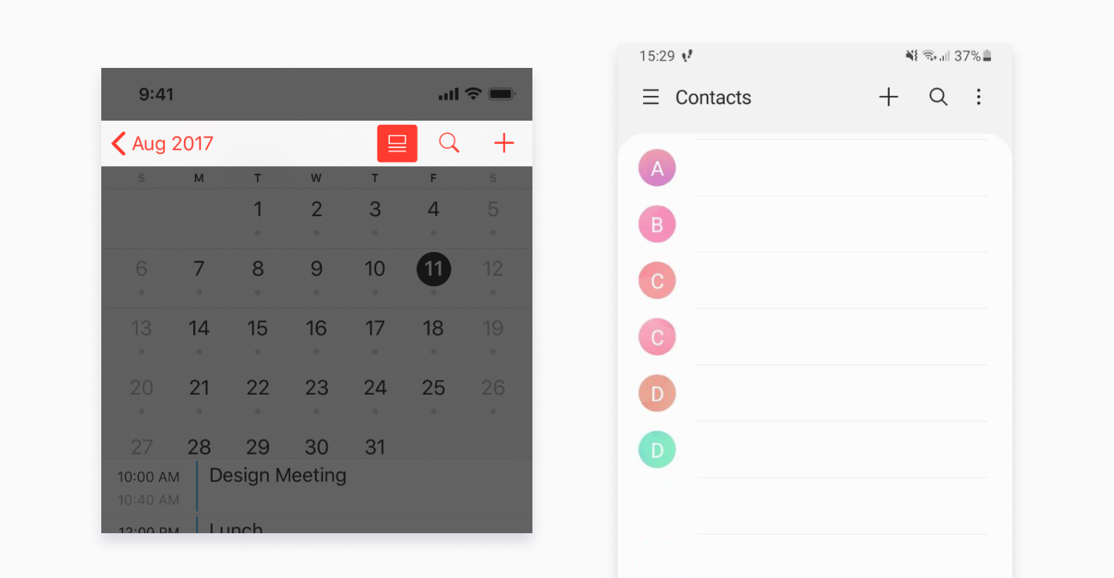
hierarchical app screens nav
design systems - material design system and apple HIG
For iOS:
Navigation Bar
For Android:
Top App Bar

Slide 32
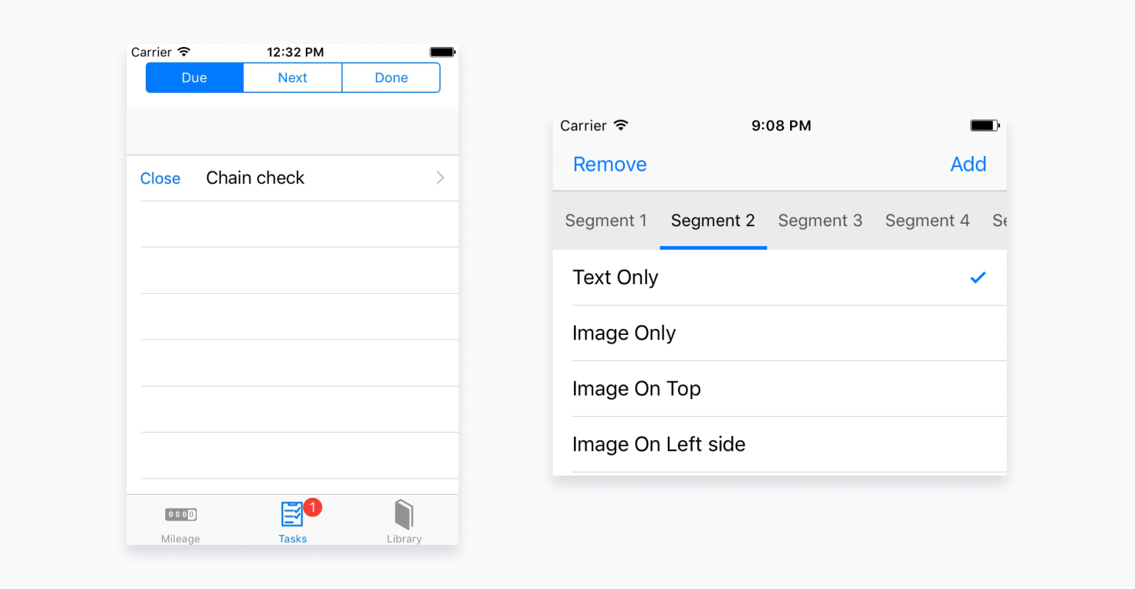
tabs
design systems - material design system and apple HIG
For iOS:
Tabs
For Android:
Segmented Controls

Slide 33
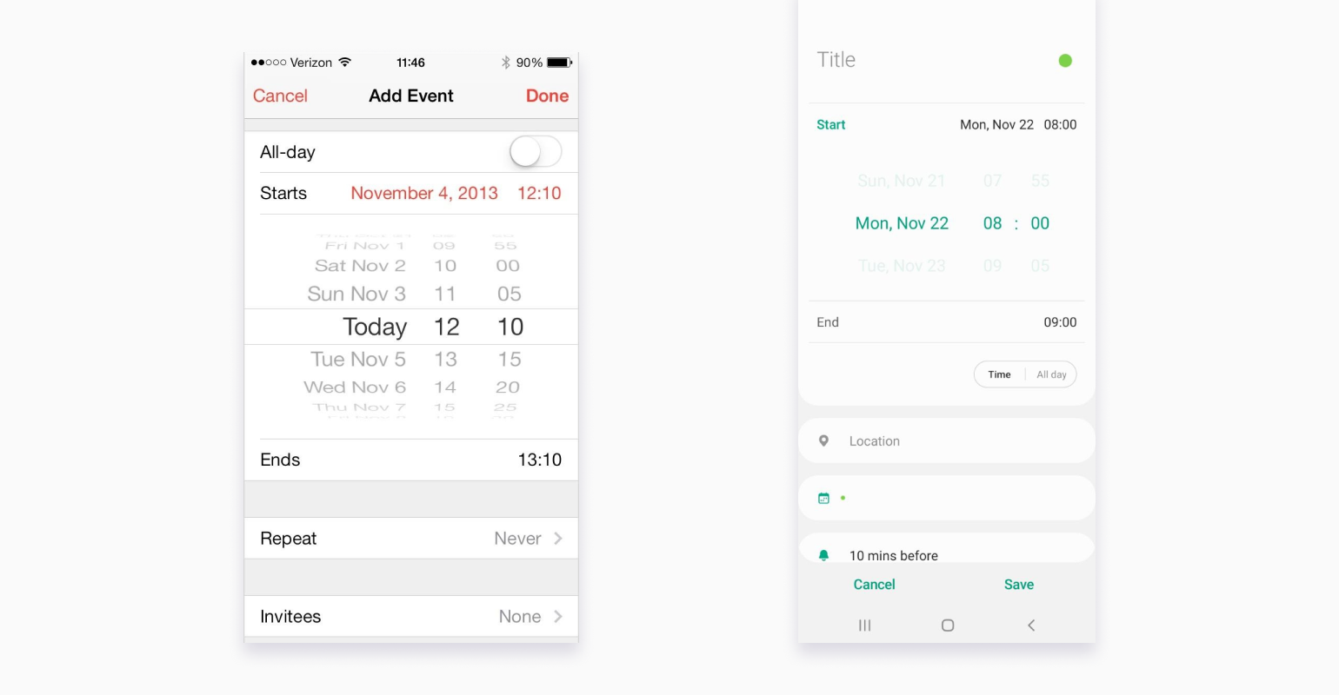
date pickers
design systems - material design system and apple HIG
For iOS:
Scrolling wheels
For Android:
Physical calendar imitation

Slide 34
to wrap up…
we discussed a few major differences between google's material design and apple’s human interface guidelines and how their principles and goals cross over slightly. these aspects contribute majorly to the arena of UI design and make apps more intuitive and user-centric for both android and IOS users.

Slide 35
resources
design system - courses and reading materials
apple HIG
material design
others
https://developer.apple.com/design/resources/
https://material.io/
https://www.uiguideline.com/components
https://material.io/blog/migrating-material-3
https://renameit.design/
https://m3.material.io/foundations/design-tokens/overview
https://component.gallery/components/quote/
https://zeroheight.com/blog/how-to-organize-your-figma-files-for-your-design-system/

Slide 36
thank you

